Slide 1
Data Mining Project
Hamed Al-Sabri 21_16-0077
Abdulrahman Al-Hejazi 21_16_0109

Slide 2
Table of contents
01
02
03
04
SVM
DBSCAN
FP-Growth
Euclidean

Slide 3

01
Support Vector Machines
Classification Algorithm

Slide 4
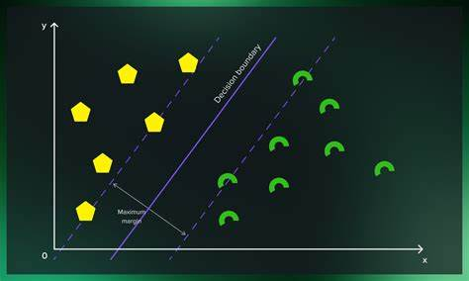
Overview
Support Vector Machines (SVM) is a supervised machine learning algorithm used for both classification and regression tasks.
It’s widely used in various fields, including pattern recognition, image analysis, and natural language processing.
The primary goal of SVM is to find an optimal hyperplane that separates data points into different classes.

Slide 5
Some of the key parameters
→ Gamma : defines how far the influence of single training examples reaches values leads to biased results.
→ C : Controls the cost of miscalculations Small C — makes the cost of misclassification LOW Large C — makes the cost of misclassification HIGH
→ Kernel : SVM algorithms use a set of mathematical functions that are defined as the kernel.

Slide 6
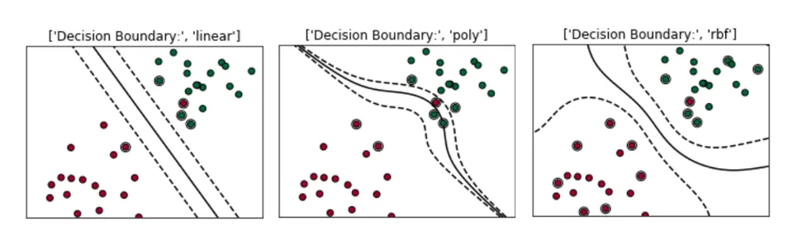
Types of Kernels are:
Linear, RBF(Radial Basis Function), Polynomial Kernel

Slide 7
How SVM Works?
Given labeled training data, SVM:
- Identifies the optimal separating hyperplane (decision boundary) that maximizes the margin between classes.
- The support vectors are the data points closest to the hyperplane.
- SVM aims to find the hyperplane with the maximum margin (distance between support vectors).

Slide 8
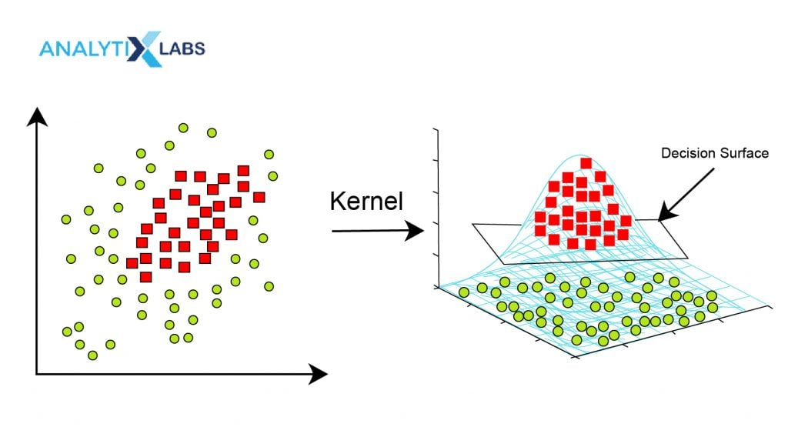
Advantages of SVM
Effective in High-Dimensional Spaces: SVM handles high-dimensional data well.
Nonlinear Transformations: It can use kernel functions to handle nonlinear relationships.
Robust to Outliers: SVM is robust even when outliers are present.

Slide 9
Applications of SVM
Text Classification: Spam detection, sentiment analysis, authorship attribution.
Image Classification: Identifying objects, faces, or handwritten digits.
Anomaly Detection: Detecting unusual patterns.

Slide 10
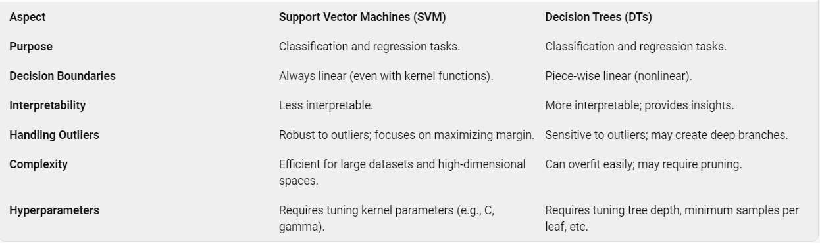
Difference between SVM and DTs

Slide 11
02
Density-based clustering
Clustering Algorithm

Slide 12
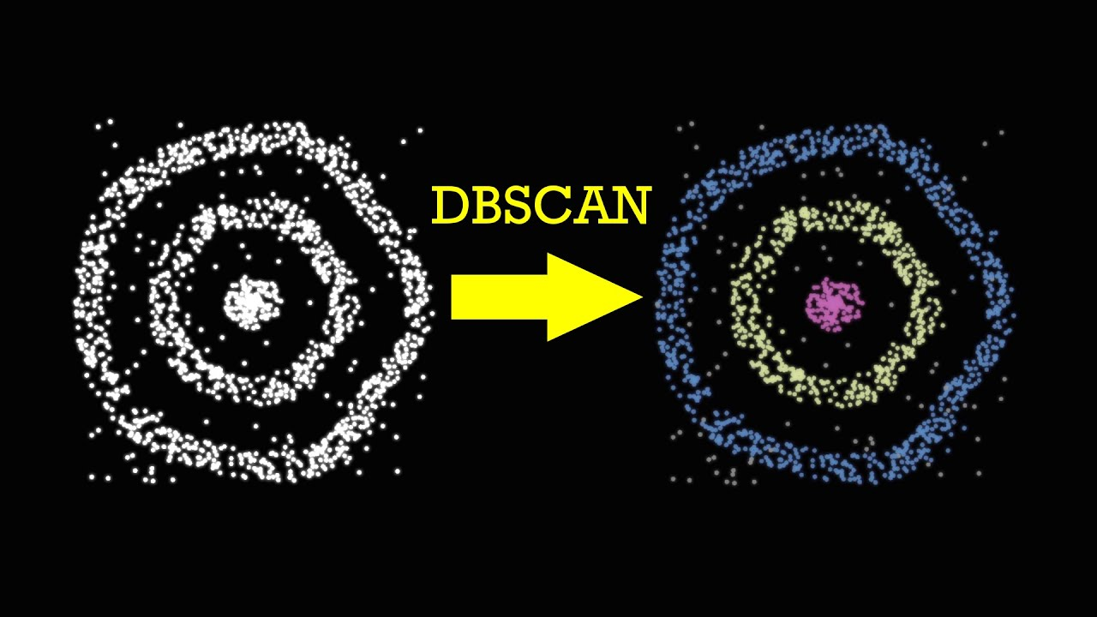
Overview
(Density-based spatial clustering of applications with noise) algorithm, one of the most useful, yet also intuitive, density-based clustering methods.
DBSCAN is a density-based clustering algorithm that groups data points based on their density in the feature space

Slide 13
Some of the key parameters
→ Core Points :Data points with a sufficient number of neighbors within a specified radius (density threshold).
→ Border Points : Points near core points but with fewer neighbors.
→ Noise Points: Isolated points with too few neighbors.
→ Parameter Selection :
Epsilon (ε): The maximum distance between two points for them to be considered neighbors.
Minimum Points (MinPts): The minimum number of points required to form a dense region (core point).

Slide 14
How DBSCAN Works?
Density-Based Clustering :
DBSCAN groups data points based on their density.
Points that are close together form clusters, while isolated points are considered outliers.
It identifies dense regions separated by areas of lower density.
Cluster Formation :
Starting from a core point, DBSCAN expands the cluster by connecting neighboring core points.
Border points are added to the cluster if they are close enough to a core point.
Noise points remain unassigned.

Slide 15
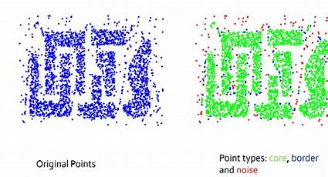
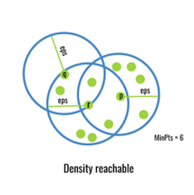
Advantages and Disadvantages
Handles arbitrary-shaped clusters.
Automatically detects the number of clusters.
Robust to outliers.
No need to specify the number of clusters in advance.
Sensitive to parameter settings (ε and MinPts).
Struggles with varying density clusters.
May not work well in high-dimensional spaces.

Slide 16
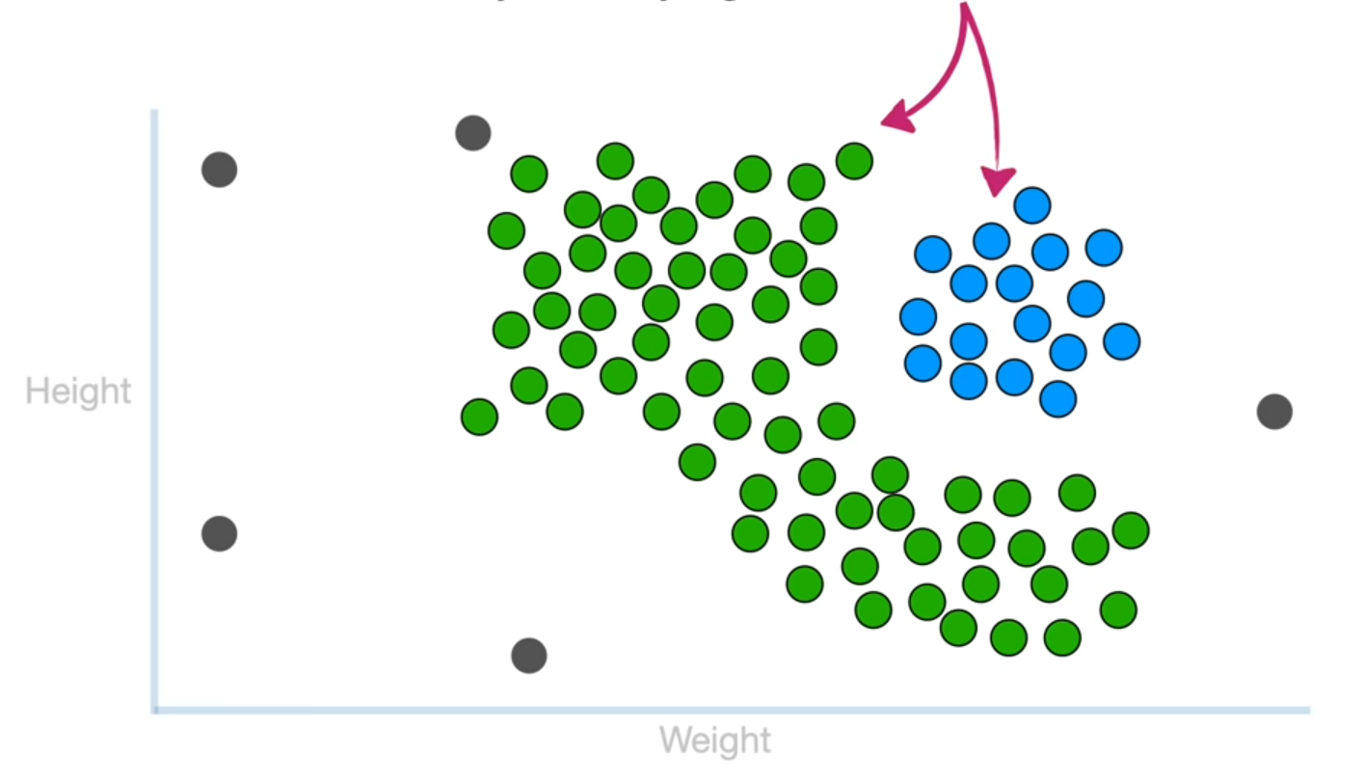
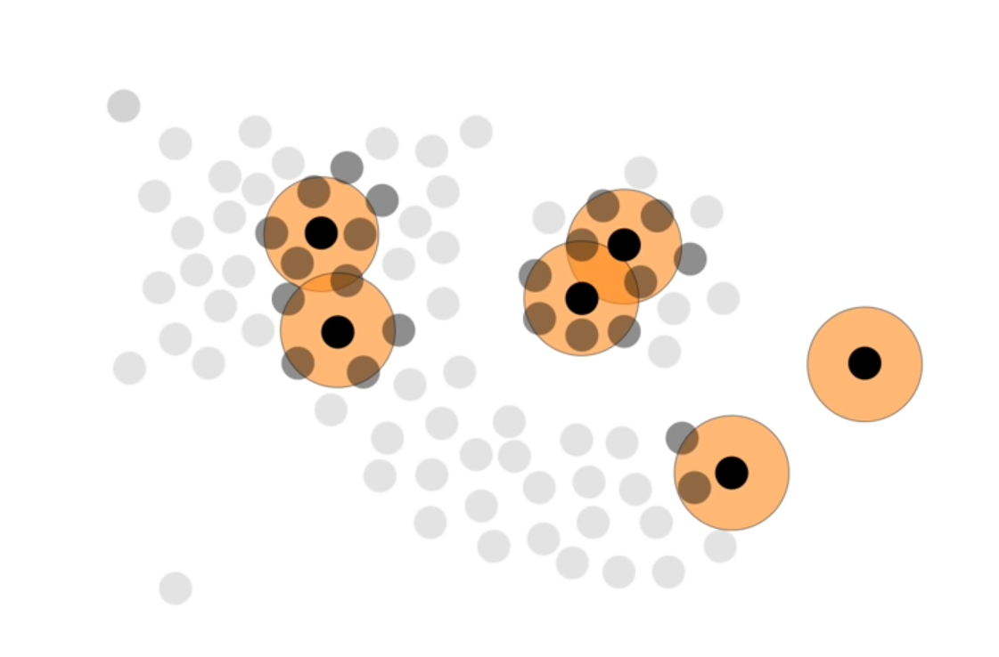
Example:

Slide 17
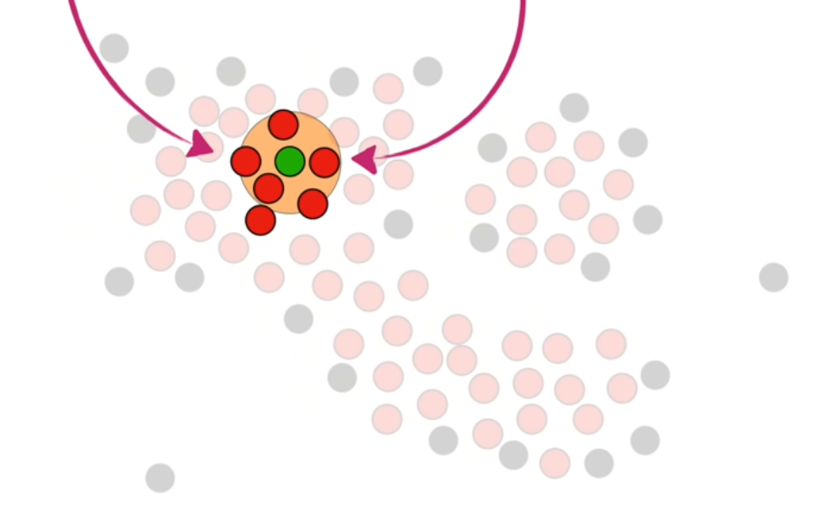
Algorithm Steps:
Density Reachability: DBSCAN identifies core points and their directly density-reachable neighbors.

Slide 18
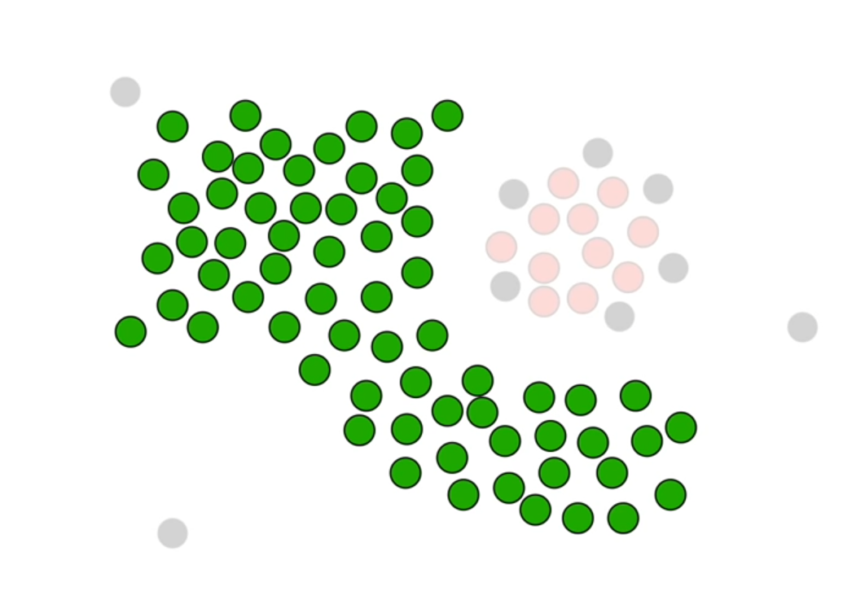
Algorithm Steps:
Cluster Formation: It forms clusters by connecting core points and their density-reachable neighbors.

Slide 19
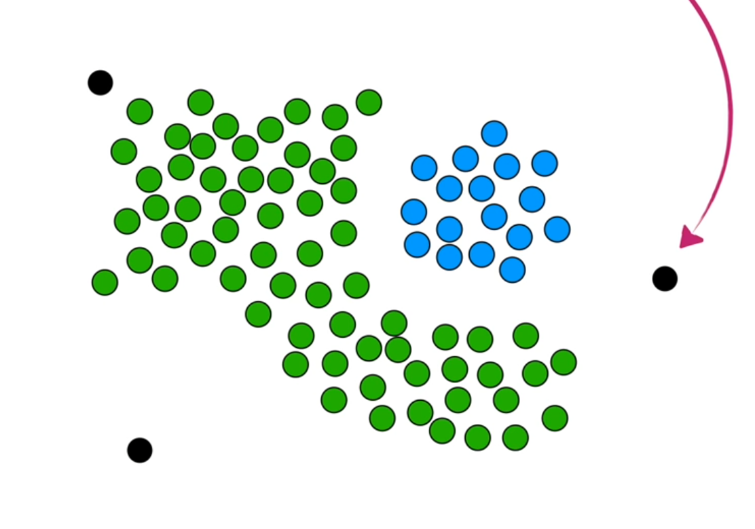
Algorithm Steps:
Noise Detection: Points that are neither core points nor density-reachable from any core points are marked as noise (outliers).

Slide 20
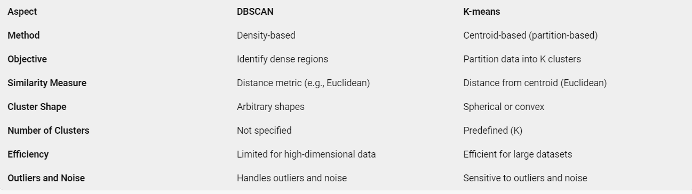
Difference DBSCAN and K-mean

Slide 21
03
FP-Growth
Association Algorithm

Slide 22
Overview
FP-Growth is an algorithm used for mining frequent itemset from a transaction database efficiently without generating candidate sets.
It represents the database in a compact form called the FP-tree (Frequent Pattern tree) and extracts frequent itemset directly from this tree.
It efficiently identifies patterns that occur frequently, which is crucial for tasks like market basket analysis, recommendation systems, and association rule mining.

Slide 23
How FP-Growth Works?
FP-Tree Construction:
The first step is to construct an FP-tree (Frequent Pattern tree) from the transaction database.
During this process, the algorithm scans the entire database once.
The FP-tree captures frequent itemsets and their support counts.
Each node in the tree represents an item, and the edges connect items that appear together in transactions.
The tree is built in a way that preserves the frequency order of items.
Mining Frequent Itemsets:
Once the FP-tree is constructed, the algorithm recursively mines frequent itemsets.
Starting from the least frequent item (singletons), it explores the tree to find all possible combinations of items.
The frequent itemsets are generated by combining the items along the paths in the tree.
The support count of each itemset is calculated directly from the FP-tree

Slide 24
How FP-Growth Works?
Conditional Pattern Base and Conditional FP-Tree
To mine frequent itemsets efficiently, FP-Growth uses a concept called the conditional pattern base.
For each item in the tree, the conditional pattern base consists of the paths leading to that item.
From the conditional pattern base, a smaller FP-tree is constructed recursively for each item.
These smaller FP-trees represent the frequent patterns associated with the item.
Recursive Mining:
The algorithm recursively applies the same process to the smaller FP-trees.
It generates frequent itemsets by combining items from different conditional FP-trees.
The process continues until no more frequent itemsets can be found.

Slide 25
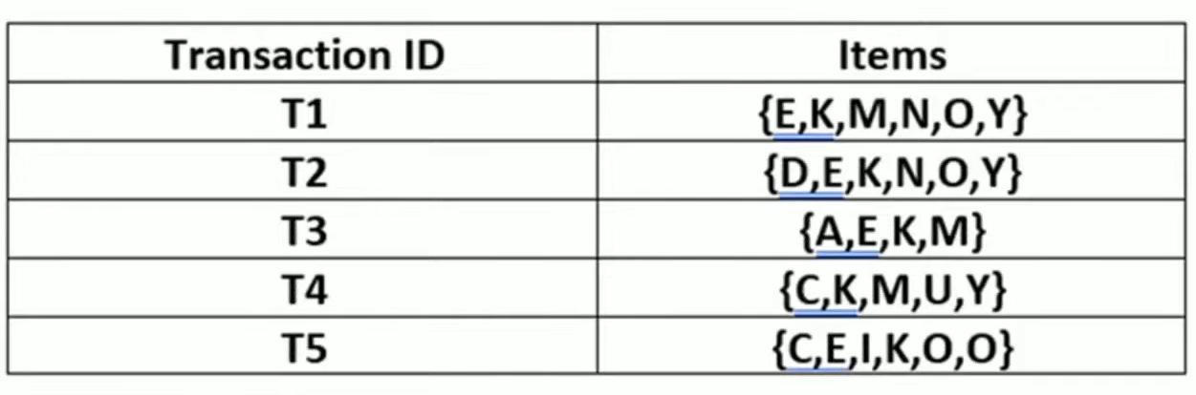
Example:

Slide 26
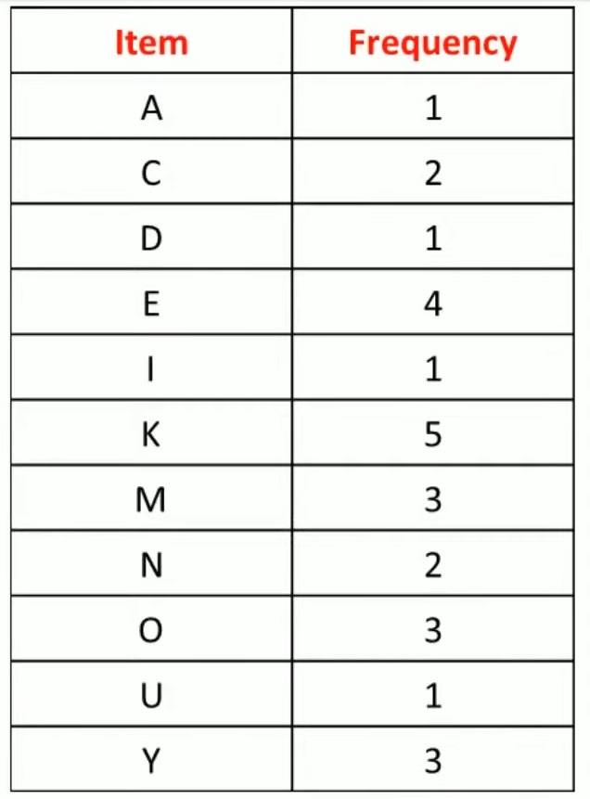
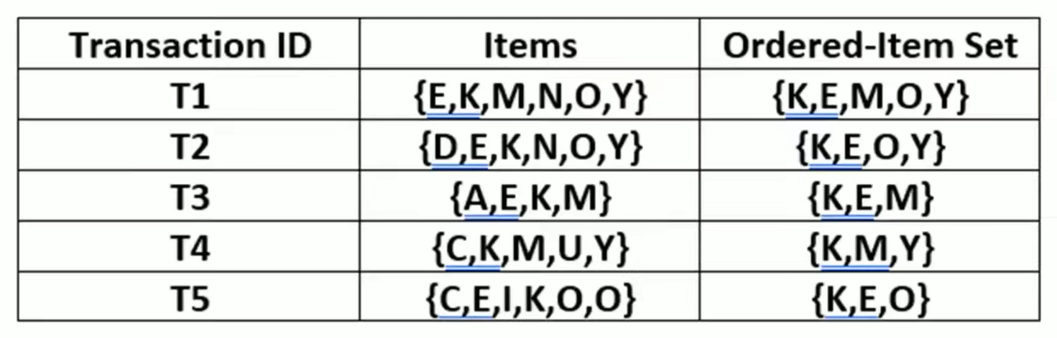
Example:
First, we find the frequency of every item.
Then we store the elements that are greater than or equal to the minimum support (3 in this case) in a descending order.
L = {K : 5, E : 4, M : 3, O : 3, Y : 3}
Now, for each transaction, the respective Ordered-Item set is built.

Slide 27
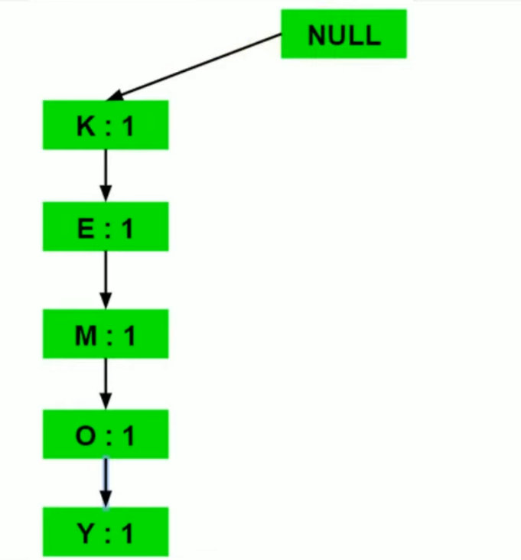
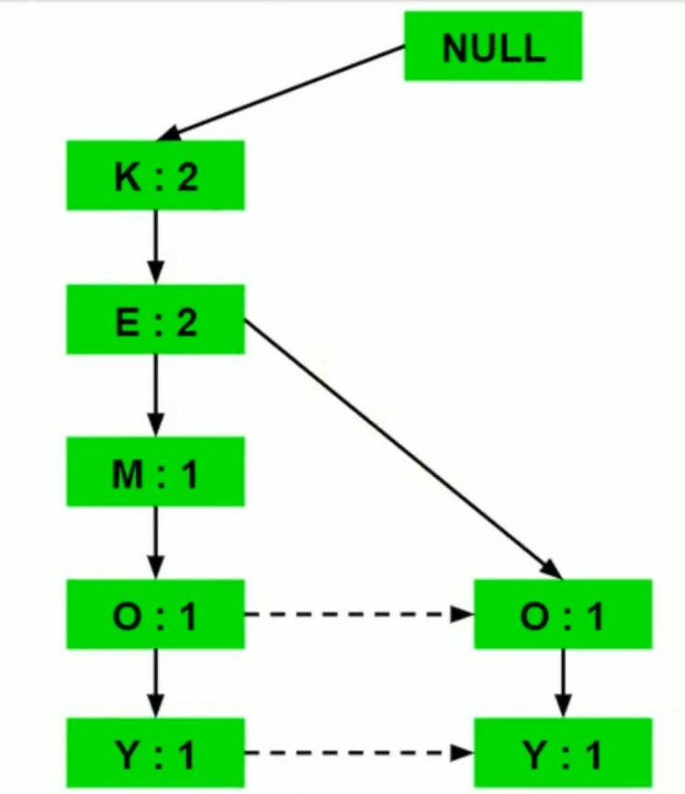
Example:
Now, all the Ordered-Item sets are inserted into a tree data structure.
We start with the null node and then for every transaction we create a path in the tree. Here for every item we created a node in the tree sequentially.
For the next transaction (K,E,O,Y) we will increment “K” and “E” by 1 and we will add “O” and “Y” as new nodes.

Slide 28
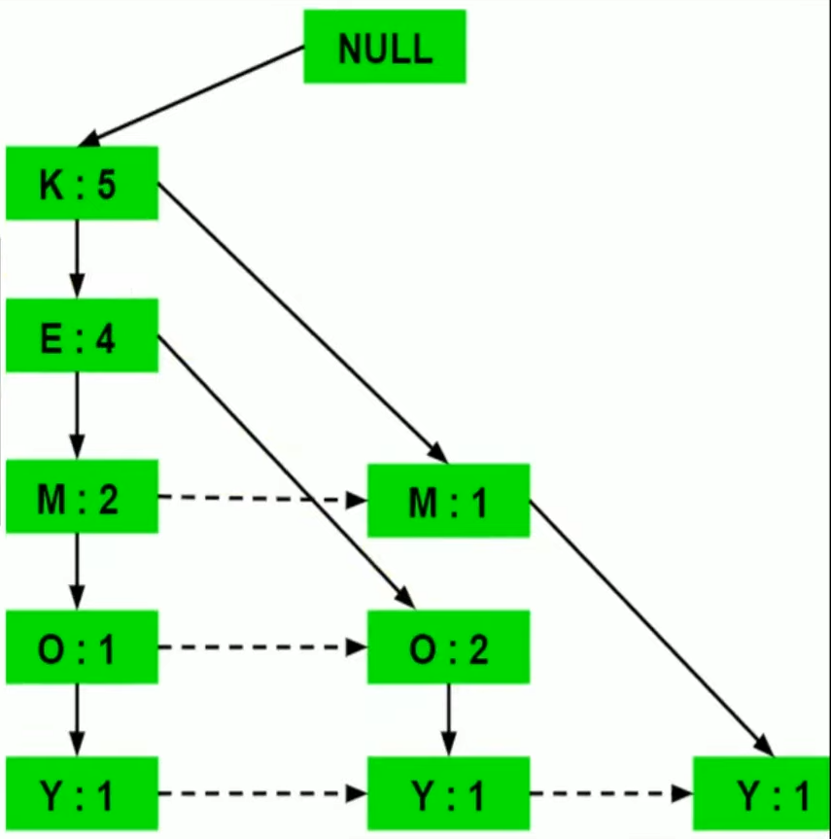
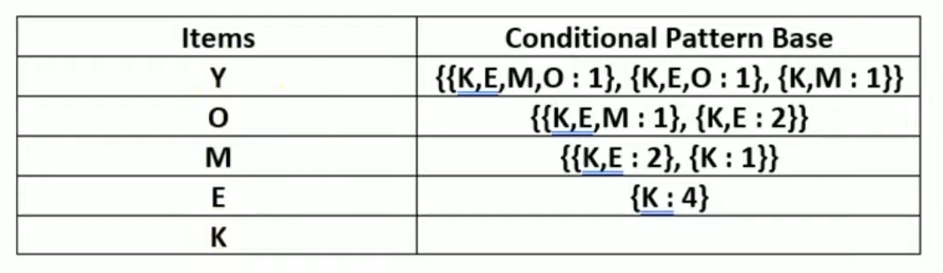
Example:
We keep repeating the same process of incrementing the frequency and adding nodes until we build the entire tree.
Now, for each item, the Condition Pattern Base is computed which is path labels of all the paths which lead to any node of the given item in the frequent-pattern tree.

Slide 29
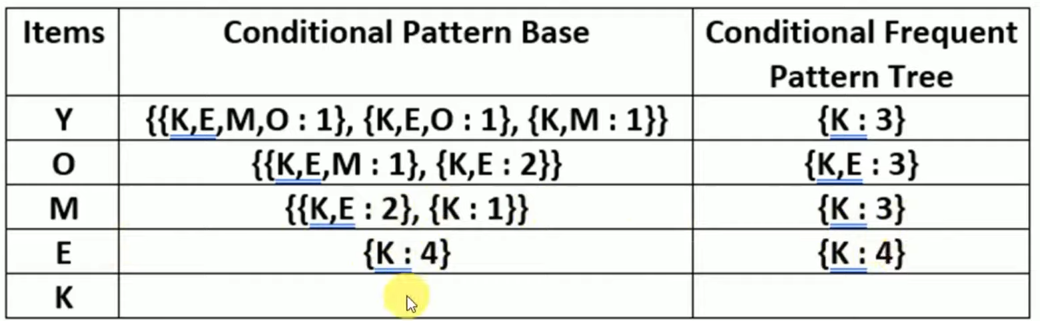
Example:
Now for each item the CPB Tree is built. It is done by taking the set of element which is common in all the paths in the CPB base of that item and calculating its support count by summing the support counts of all the paths in the CBP base.

Slide 30
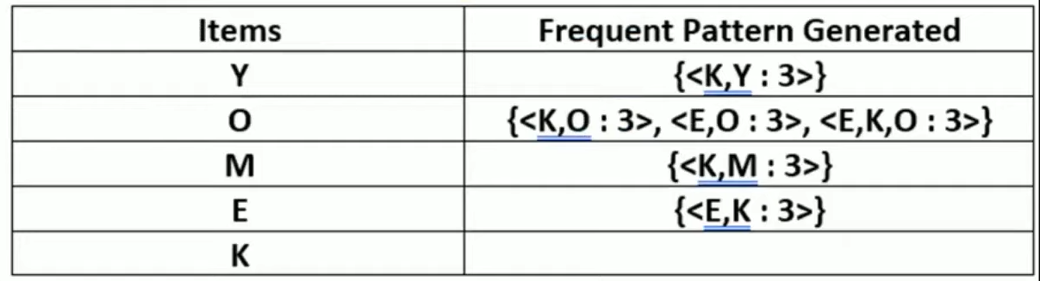
Example:
From the Conditional Frequent Pattern tree, the Frequent Pattern rules are generated by pairing the items of the conditional frequent pattern tree set to the corresponding item

Slide 31
Example:
In the table in the previous slide, we can consider one frequent pattern then try to write all possible rules.
For example {<K,Y :3>} in the table, the possible rules are:
K tends to Y or
Y tends to K
Then we calculate the confidence of each one of the rules, if either one of the rules satisfies the minimum confidence then that one is the association rule.
And if both of them satisfy the minimum confidence then both of them are the association rule.

Slide 32
Advantages
Efficiency: Unlike the Apriori algorithm, which generates candidate itemsets, FP-Growth requires only a single pass over the database.
No Candidate Generation: By avoiding candidate generation, FP-Growth eliminates the need to generate and test large sets of potential itemsets.
Compact Representation: The FP-tree reduces memory usage by representing the data compactly.

Slide 33
Use Cases FP-Growth:
Market Basket Analysis: Discovering associations between items purchased together.
Recommendation Systems: Suggesting related products or content based on user behavior.
Bioinformatics: Identifying frequent patterns in DNA sequences.

Slide 34
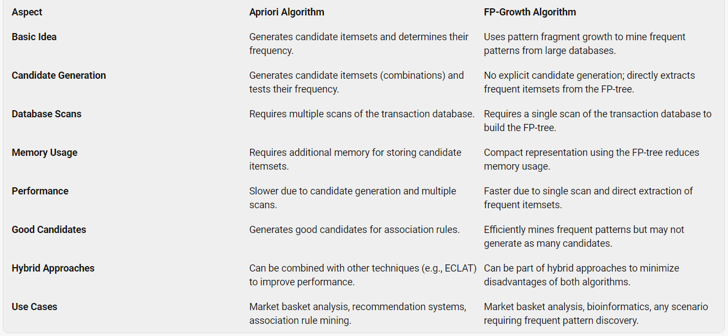
Difference Between FP-Growth and Apriori

Slide 35
04
Euclidean
Similarity Algorithm

Slide 36
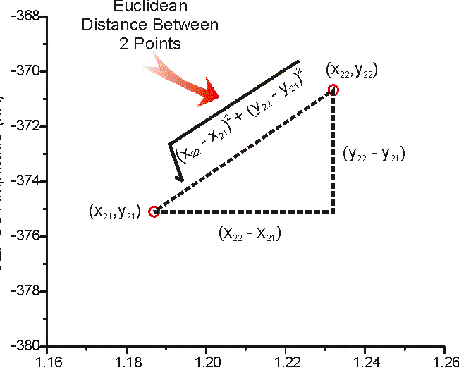
Overview
- Euclidean distance calculates the distance between two real-valued vectors.
- You are most likely to use Euclidean distance when calculating the distance between two rows of data that have numerical values, such a floating-point or integer values.

Slide 37
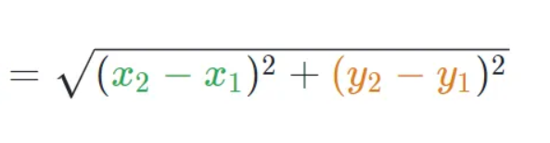
Formula:
- Euclidean distance is calculated as the square root of the sum of the squared differences between the two vectors.
- EuclideanDistance = sqrt(sum for i to N (v1[i] — v2[i])²)
In a 2-dimensional space, the Euclidean distance between two points

Slide 38
How does Euclidean Distance Work?
Given two points, compute the differences in their coordinates (e.g., (x_2 - x_1), (y_2 - y_1)).
Square each difference.
Sum up the squared differences.
Take the square root of the sum to obtain the Euclidean distance.

Slide 39
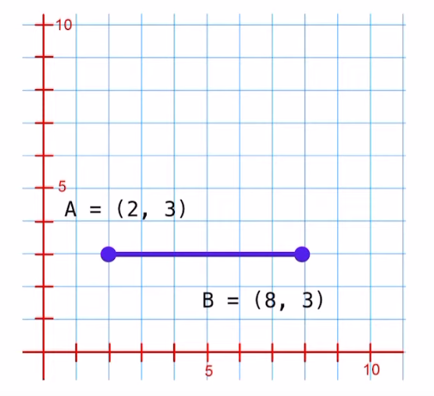
Example:
A= (2,3)
B= (8,3)

Slide 40
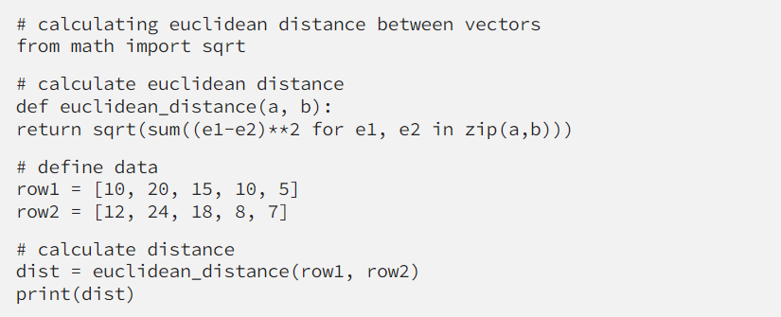
Example:
We can demonstrate this with an example of calculating the Euclidean distance between two real-valued vectors, listed below.:
Output: 6.082762530298219

Slide 41
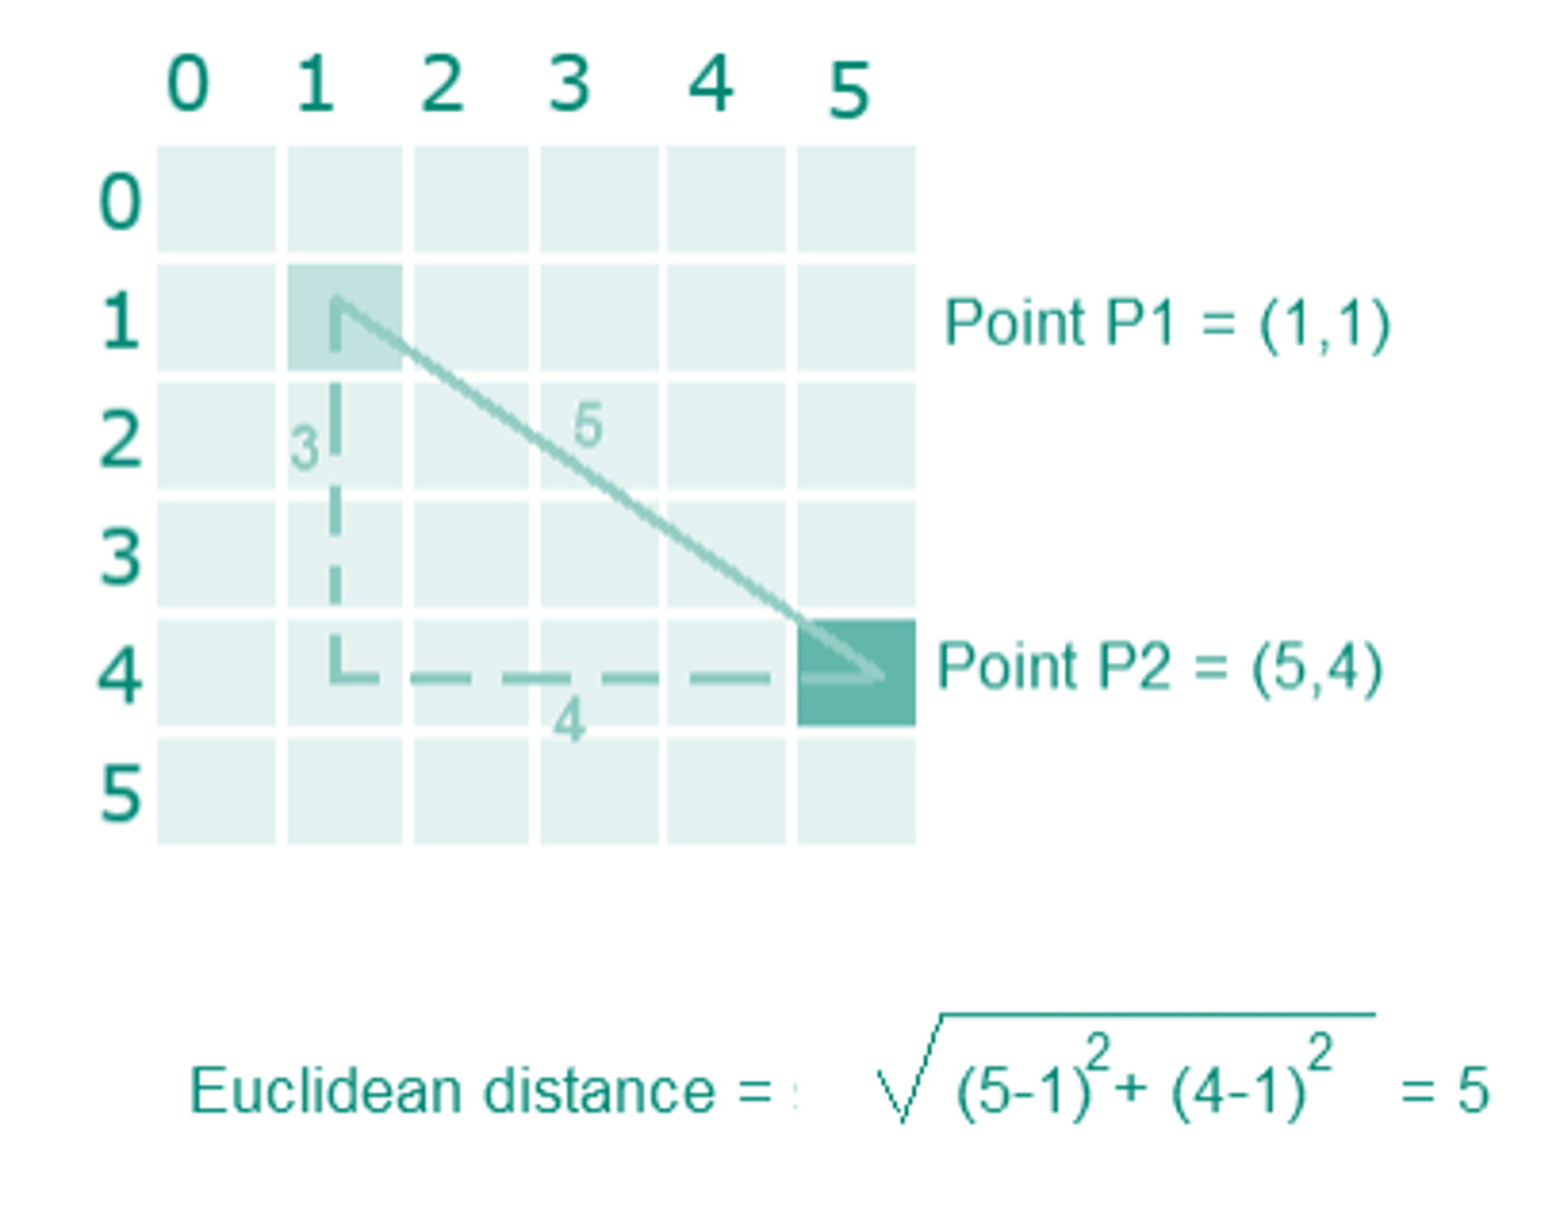
Example:

Slide 42
Advantages
Simplicity:
The calculation is straightforward and intuitive.
Easy to interpret and understand.
Applicability Across Dimensions:
Euclidean distance works seamlessly in 2D, 3D, or higher-dimensional spaces.
Remember that Euclidean distance captures direct spatial relationships but does not account for other factors (e.g., obstacles, terrain).

Slide 43
Use Cases Euclidean:
- Optimization Problems:
Finding the shortest route for a delivery truck (e.g., from depot to delivery point).
Calculating distances between stars in space science.
Segmenting shoppers based on similar preferences in marketing.
- Image Recognition:
Measuring color differences between image pixels (e.g., RGB values).
- Movie Recommendation:
Assessing similarity in movie ratings.
- Healthcare Diagnostics:
Comparing health indicators (e.g., blood pressure) between patients.
- Social Network Analysis:
Studying connectivity in network graphs.

Slide 44
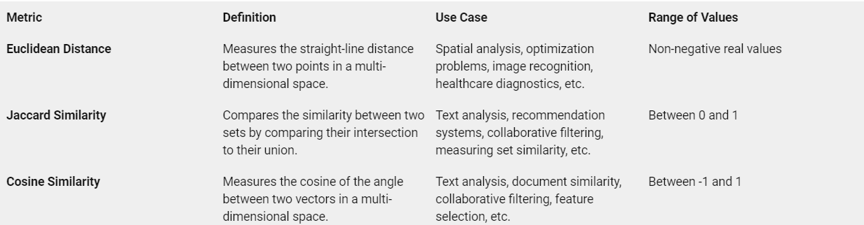
Difference Between Euclidean and Other Algorithms

